Slide 1
Women`s liberation and the Environmental movement
Erin Kim
Caroline McCloskey
Helena Mckendrick

Slide 2
thesis
Anti-War protests and the civil rights movement created the backdrop for activist groups (women and environmentalist groups) to express grievances and initiate social reform.

Slide 3
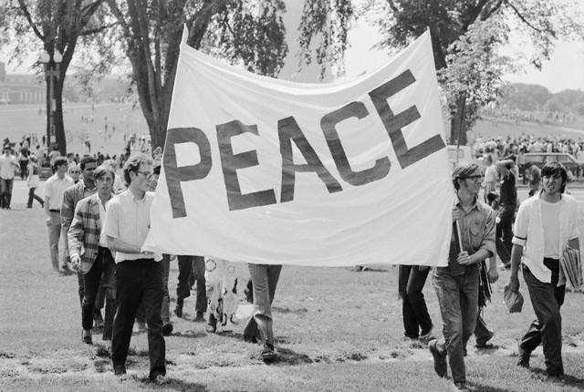
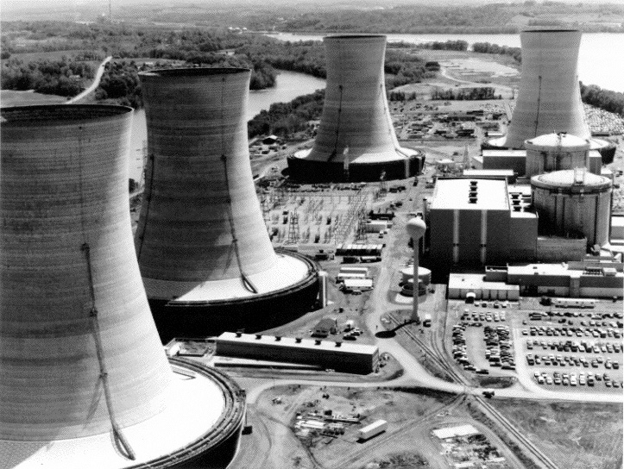
background
African-American Civil Rights Movement and anti-war protests motivated Women for liberation
Three Mile Island accident brought environmental awareness

Slide 4
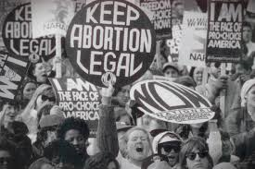
Storyline
Equal Rights Amendment (1923)
Unsuccessful
National Organization for Women
Against sex discrimination
Demand abortion and birth control laws
Roe vs. Wade (1973)
Deemed anti-abortion laws a violation of women’s rights

Slide 5
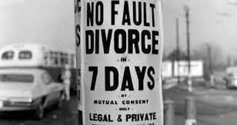
Storyline cont.
Feminization of poverty
No fault divorce
Economic struggles for women as head of households
The New Right
Anti-ERA: Schlafly’s STOP ERA campaign
Anti-abortion/ pro life cause: rights of the unborn

Slide 6
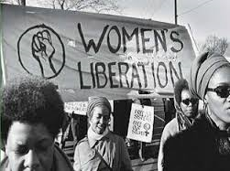
Outcome- Women
ERA was never passed
Women take part in politics
Better pay for women

Slide 7
Storyline cont.- Environmental mvm
Rachel Carson’s Silent Spring
Book to bring awareness to harsh pesticides
Environmental Protection Agency
1970
Bills to improve environmental conditions

Slide 8
Outcome- Environment
EPA became largest federal regulatory system
Americans become environmentally conscious
The creation of Earth day
Nelson and McCloskey
20 million gathered in public

Slide 9
trends
Political turmoil caused by civil rights movement and anti-war protests established battleground for women’s and environmental movements
Although goals of the movements were not fulfilled to the extent, they bettered the situation for the activists
Power of the people was proven when rallied behind a cause

